Slide 1
Establishment and Management of the OsloMet - Oslo Metropolitan University
Tale Skjølsvik
Professor of technology management
Vice-Dean for Innovation and work life
Faculty of technology, art & design

Slide 2
Notes:
OsloMet har det viktige oppdraget med å levere kunnskap i form av stadig oppdatert forskning på verden rundt oss, og yrkesutøvere som samfunnet er helt avhengige av.
OsloMet er tett på arbeidslivet og praksisfeltet, slik at vi kan svare på velferdssamfunnets behov til enhver tid.

Slide 3
Delivering knowledge to solve societal challenges
Notes:
Dette er visjonen vår (fra Strategi 2024)
Utfyllende:
Vi utdanner kandidater som skal ut i jobber som handler om å ta vare på medmennesker i alle livets faser, og som er grunnleggende for at velferdssamfunnet skal gå rundt på en best mulig måte.
Vi tilpasser oss samfunnets endringer, og skal være relevante i vår forskning og utdanning til enhver tid.
Som universitet kan vi styre dette best mulig selv – betingelsene og forutsetningene ligger til rette for at vi stadig kan levere bedre forskningsbasert kunnskap og utdanning.

Slide 4
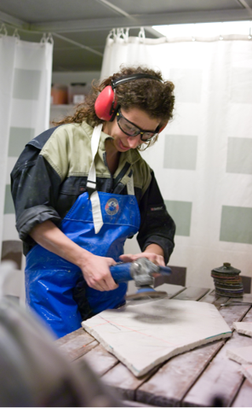
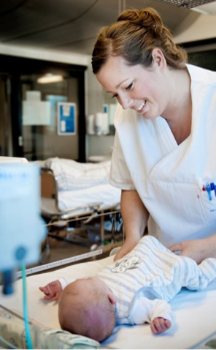
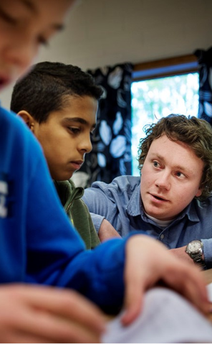
Who we are
22 000+ students
2 200+ staff members
48 Bachelor’s Degree Programmes
33 Master’s Degree Programmes
6 PhD programmes
4 Faculties
5 Research Centres
2 Campuses
Notes:
Utfyllende:
Blant prioriterte aktiviteter:
Rekruttere vitenskapelig personale som ønsker å være i front nasjonalt og internasjonalt på forskning og utdanning
Gode tilbud om kompetanseheving for ansatte, og satse på lederutvikling for faglige, tekniske og administrative ledere
Forbedre og effektivisere administrative støttetjenester
Tilby digitale løsninger som førstevalg for alle som vil kommunisere med institusjonen
Utvikle moderne og bærekraftige universitetscampuser med rom for flere studenter og nye lærings- og samarbeidsformer
Health
Social sciences
Education and international studies

Slide 5
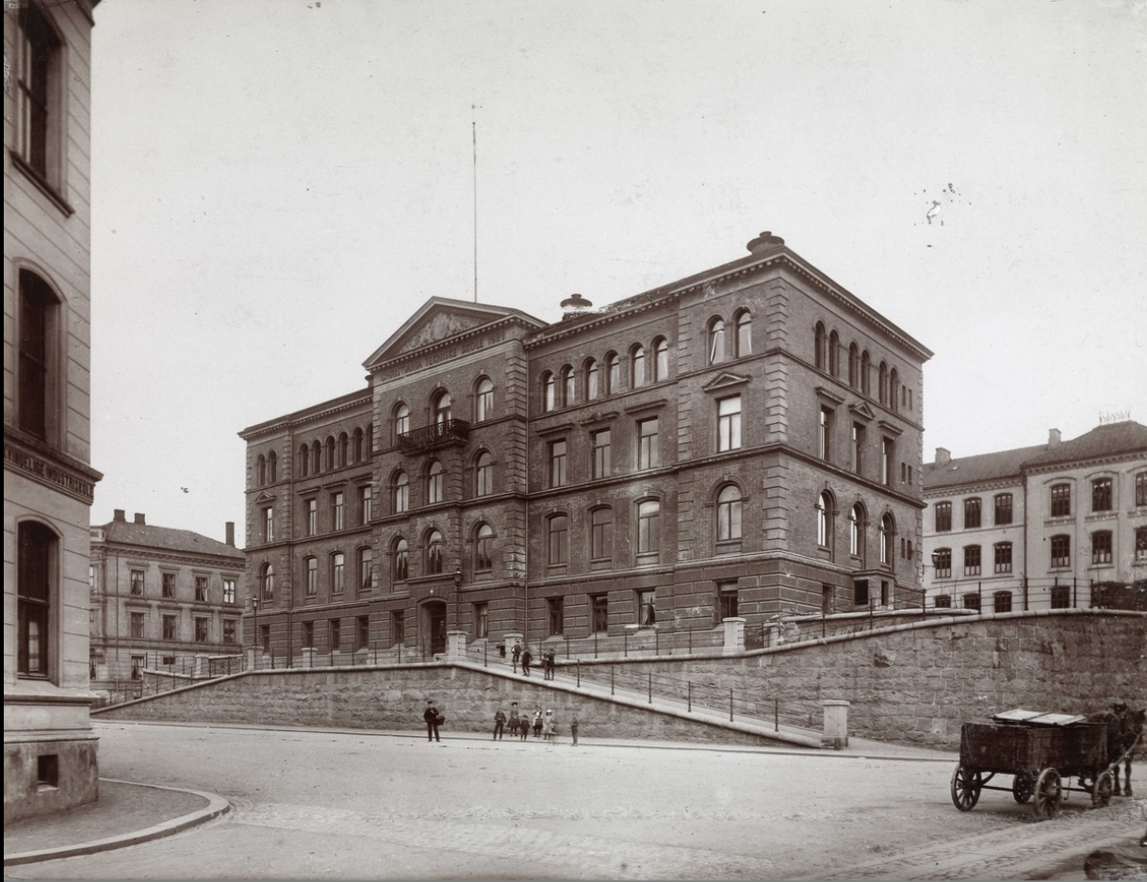
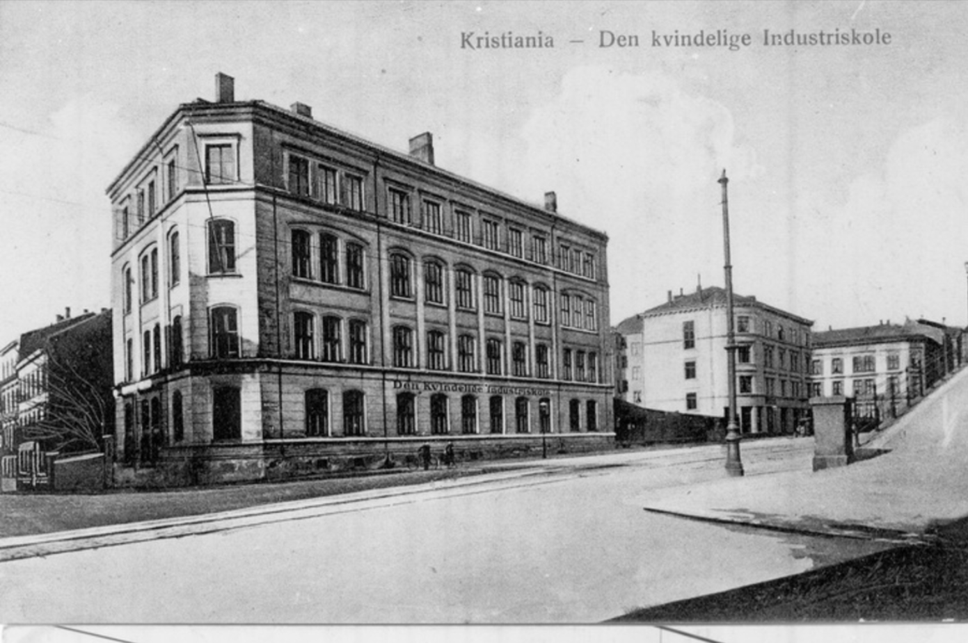
Where did OsloMet come from?

Slide 6
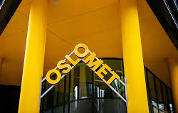
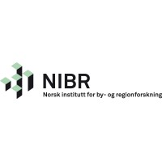
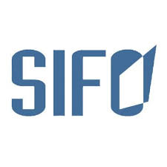
Where did OsloMet come from? 3 phases: - Mergers, university establishment and rebranding

Slide 7
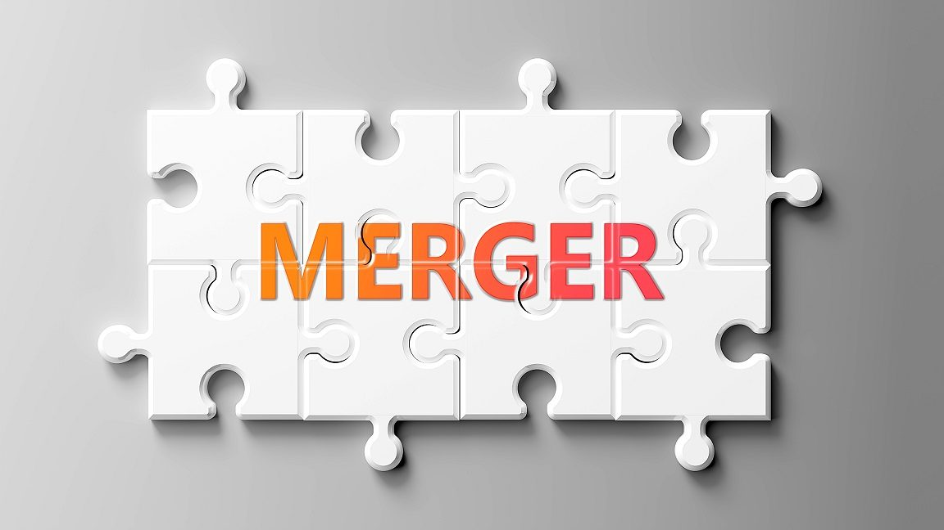
What are potential benefits and liabilites of a MERGER?
Size
Opportunity to become a university
Brand
Recognition
Political positioning
Scale and scope benefits?
Complexity and administrative burdens
Duplication of functions
Regression to the mean in quality?
Differentiation overshadowed by large organization
Need for multiple governance levels

Slide 8
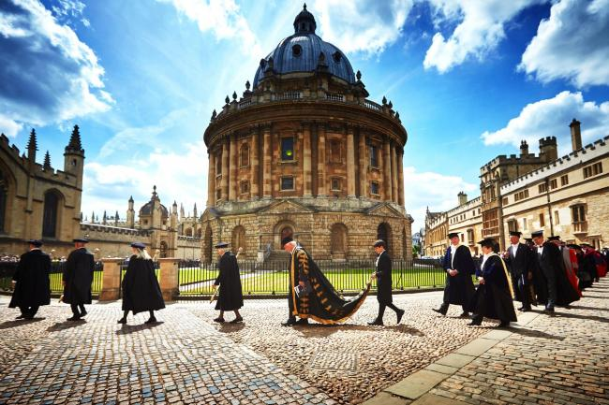
What are potential benefits and liabilities of becoming an UNIVERSITY?
Self-accreditation
Increased focus on research
Increasing scope of activities
Prestigue
External recogniction
And more…
Theoretification and decreasing relevance?
Research and publications over teaching?
Hiring of PhDs over practitioners?
Increasing demands on the organization
And more….

Slide 9
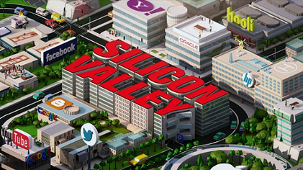

Slide 10
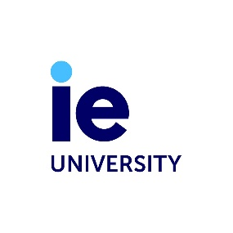
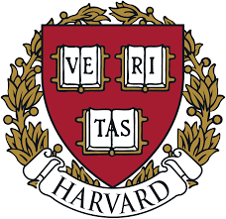
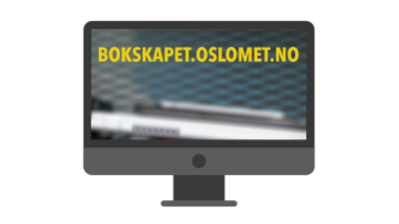
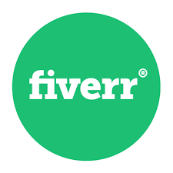
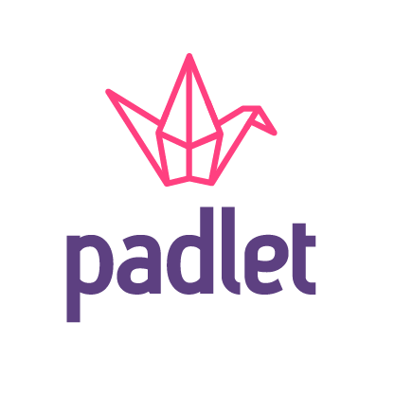
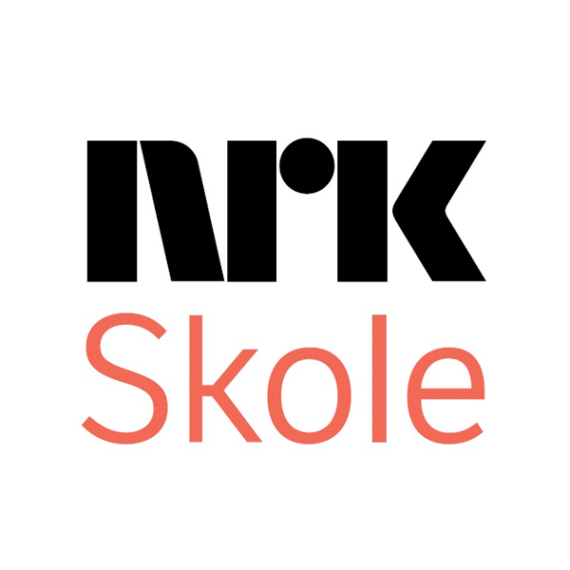
What is our sector?
Researchinstitutes
University and HE sector
Private/public organizations
Publishers
Norwegian
Consulting firms
Unions
International
Meeting spaces
Platforms
Alternative modells
EdTech
Tech
Media

Slide 11
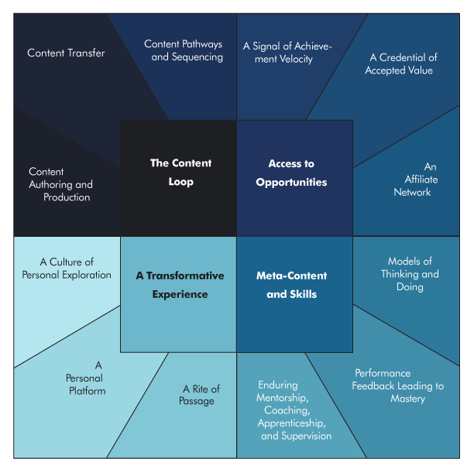
What is an university degree?
Knowledge acqusition
Kilde: Staton, M. (2012). Disaggregating the components of a college degree. American Enterprise Institute, Washington, DC.
Notes:
I Amerikansk sammenheng:
• The Signal of Achievement Velocity is interpreted from U.S. News World and Report rankings on selectivity. There is an admissions tournament, and the brightest high school students are thus let into a hierarchy of institutions, about which society seems to assume a certain trajectory of achievement and success. Those who get into Princeton, many assume, will on average outpace those who get into Texas A&M. Take away the four years of school, and the tournament still sends similar signals about those who “got in” to selective schools. • School is not just about the admissions process, it adds value with the education provided. A Credential of Accepted Value communicates a certain rigor and minimum expectations about the skill sets and knowledge base of graduates. So while Texas A&M may not beat out Princeton in the admissions game, their degree holders in engineering may have more value than those who majored in “softer” subjects at Princeton. Open
A Rite of Passage is a relatively unique series of experiences that create a common bond between participants, often regardless of time. This creates a multiplier on the affinity network, and also allows individuals aware of the brand to make assumptions about another graduate’s experience.

Slide 12
Physical
Digital

Slide 13
Physical
Digital

Slide 14
Can we think of universities as platforms?
«Where we meet»
Software/Apps
Data
Network-
externalities
Ecosystem
Digital platform
Collaboration
The hybrid university
Value
Physical platform
Lay-out
Access
Use
Network/
ecosystem

Slide 15
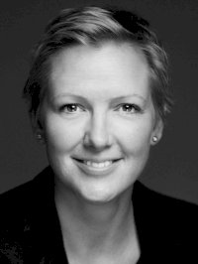
Please do make contact talesk@oslomet.no Tale Skjølsvik Professor og Vice Dean Faculty of technology, art & design OsloMet

