Slide 1
Life in ESA: a New Member State’s perspective
© Tõnis Eerme (Invent Baltics)
Riga, January 2017

Slide 2
Presentation outline
Estonia’s accession to ESA
Activation of Estonian industry
Economic impacts from ESA membership: a small country’s perspective
Estonian industry in ESA - overview and self-reflections

Slide 3
Invent Baltics is...
A boutique-style consultancy firm specializing in assisting Nordic companies and R&D organisations acquire non-dilutive funding (mostly Horizon 2020)
Established 2006
Sales in >10 markets
12 people

Slide 4
Invent Baltics and (aero)space
Long-term partner of Estonian Space Office – industrial liaison, impact assessments
Coordinator of two FP7 projects – NANOSAT and BEAWARE
ESA contract – „Ex ante assessment of multiplier effects induced by space investments from very small ESA candidate countries’ perspective“ (2013-2015)

Slide 5
Estonian road to ESA

Slide 6
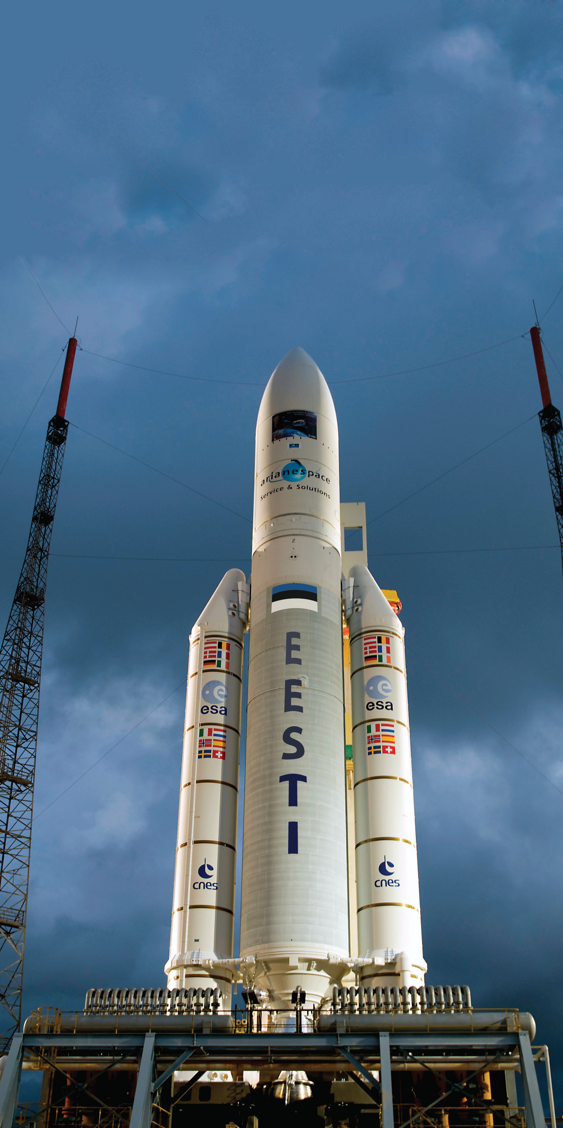
Milestones (1)
2006 1st consultations
June 2007 Cooperation Framework Agreement
VISION in 2007 for 2016
2016 Estonia accedes ESA Convention
Space industry is an important contributor to Estonian GDP
Dream! (2007)

Slide 7
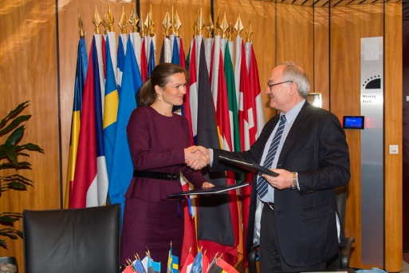
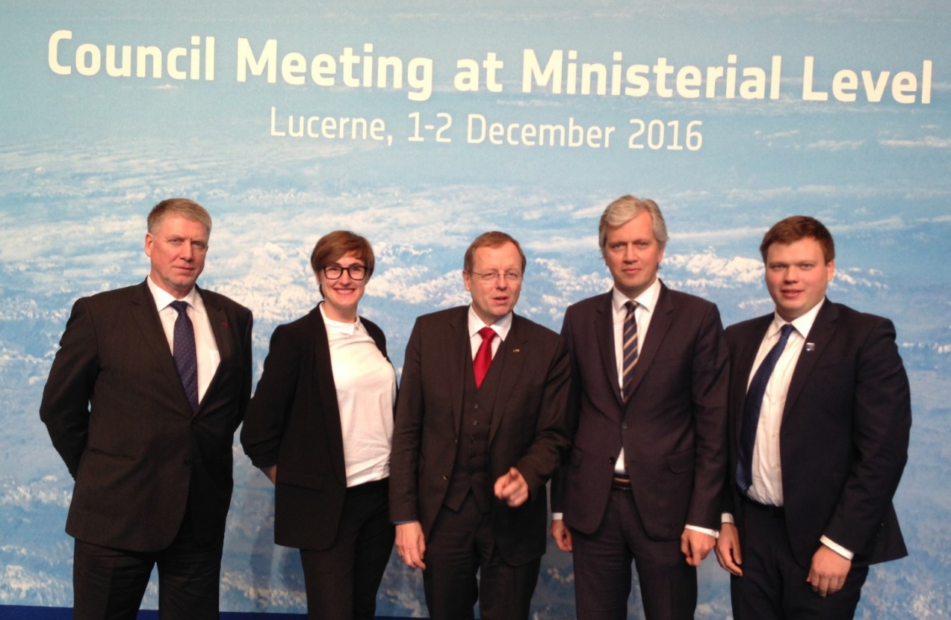
Milestones (2)
Nov 2009 European Cooperating State Agreement
Sept 2010 PECS Charter Signed
Feb 2015 Estonia and ESA signed the Accession Agreement
Dec 2016 The 1st ESA CM meeting in Lucerne

Slide 8
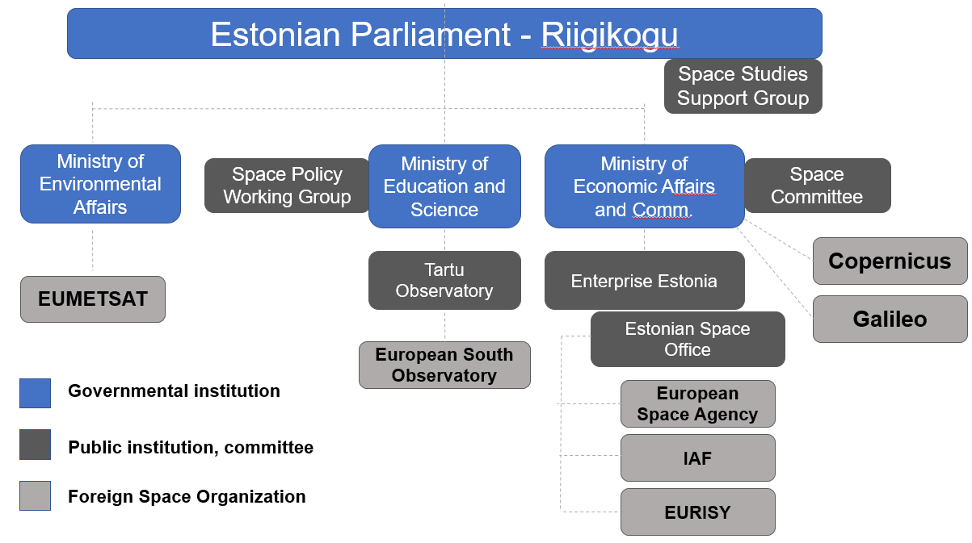
Space governance ...during the accession process
Dr Ene Ergma 2003-2014 President of the Parliament
Mr Madis Võõras
Head of ESO

Slide 9
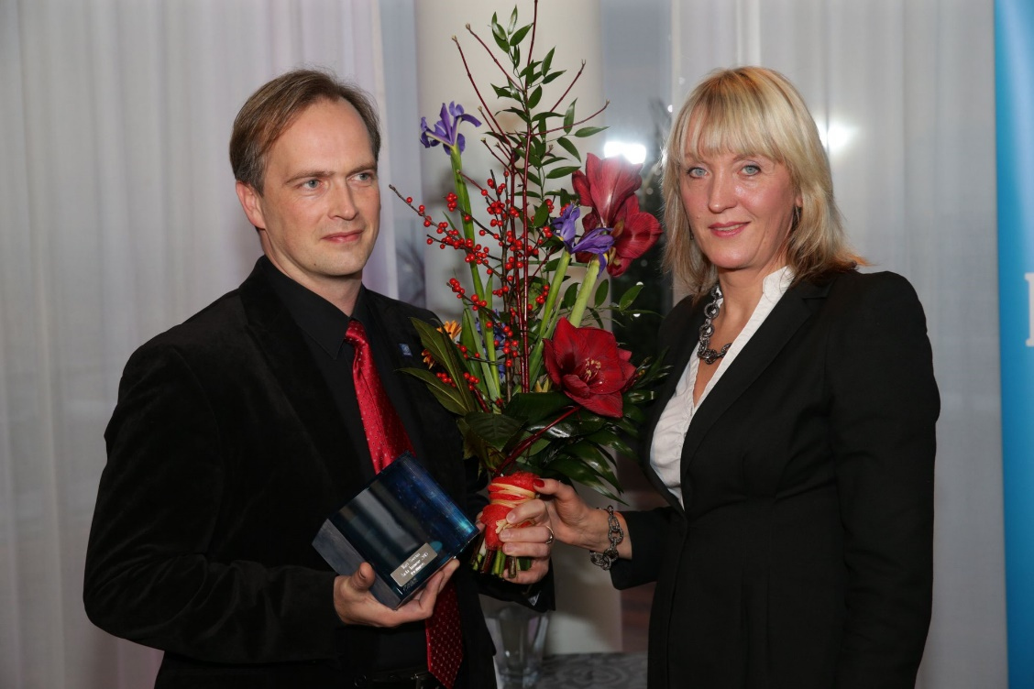
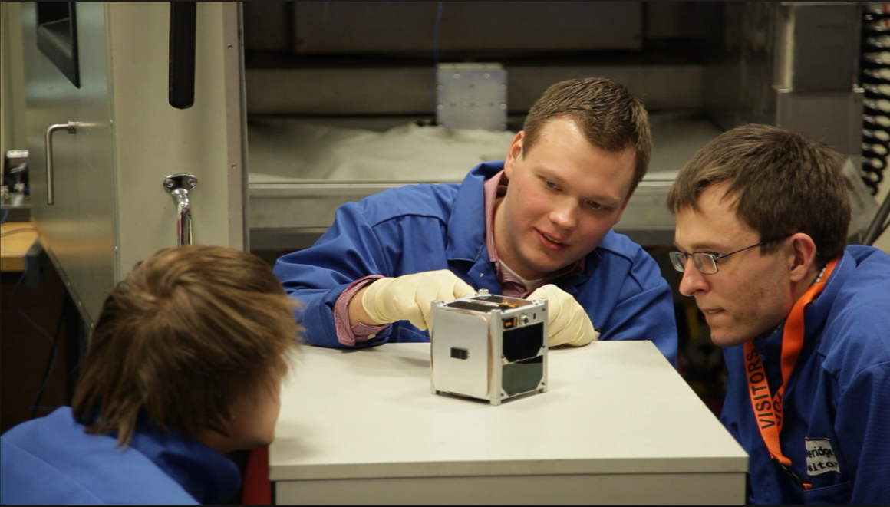
Public opinion
EstCube-1 success story
Launched May 2013
Screenshot from documentary
Instructions On How To Build A Spaceship (2015)
Dr Mart Noorma, Person of the Year 2013

Slide 10
Industrial liaison

Slide 11
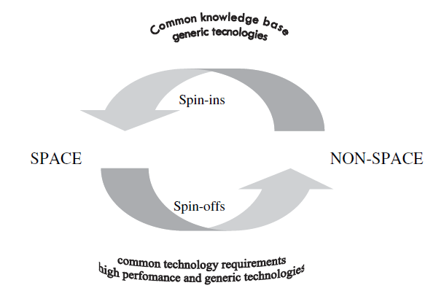
Lack of conventional space industry
2007-2009 Mapping of the industrial potential (database of 400 companies)
Common knowledge base
Generic technologies
Common technology requirements
High performance and generic technologies
Source: ISU - International Space University. Bridging space and society with technology transfer. Space Policy 1997;14:49-60

Slide 12
Awareness raising and international cooperation (1)
2008-2009 1st study tour to ESTEC and dedicated training sessions (with International Space University)
2009 More study tours to ESRIN, DLR, EADS Astrium, and UK Space; more training seminars
2010 Space Downstream Services conference

Slide 13
Awareness raising and international cooperation (2)
2010-2012 NordicBaltSat project – dedicated trainings and Space Awareness Action Programme
2014 Study tour to Thales, seminars about ESA relevant programmes
2015-2017 seminars for public sector and industry about ESA programmes, tendering system and governance

Slide 14
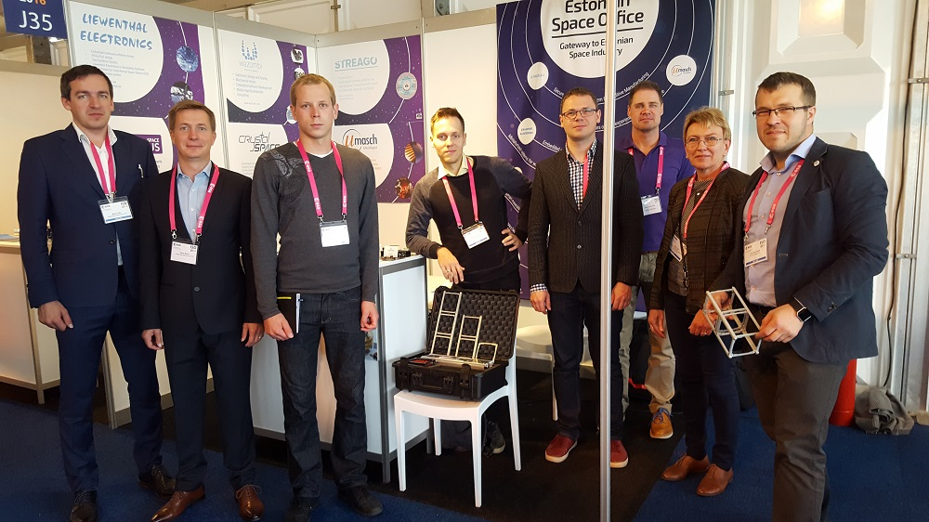
Awareness raising and international cooperation (3)
2016 Industry Space Days 2016

Slide 15
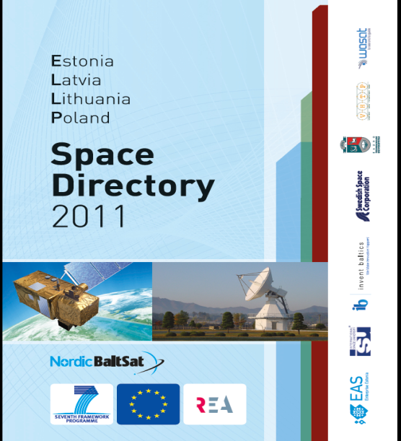
Mapping and technology audits (1)
2007-2009 Mapping of the industrial potential (database of 400 companies)
2008 The 1st ESA Technology Audit
2010-2011 Space Directory of Estonia, Latvia, Lithuania, and Poland

Slide 16
Mapping and technology audits (2)
2012-2013 Matching records in databases with ESA Technology Tree (60 companies)
2014 ESA (pre-accession) Technical Visit (presentations of 17 companies)
2015 Missions of ESA and Large System Integrators (company visits and speed dating)

Slide 17
Conversion to industrial activity
36 ideas for the 1st PECS call in 2010
13 funded, including 8 from industry
18 proposals for the 2nd PECS call in 2013
10 funded, incl 7 from industry
ESA-STAR – around 40 companies registered
10 companies are ready to compete for IIS

Slide 18
Economic impacts from ESA membership for small ESA member states

Slide 19
Large research infrastructures

Slide 20
Public Procurement for Innovation
PPI is the purchase of a not-yet existing product or system whose design and production will require further, if not completely novel, technological development work.
Source: Edquist, C., Hommen, L., 2000. Public Technology Procurement and Innovation Theory, in: Edquist, C., Hommen, L., Tsipouri, L. (Eds.), Public Technology Procurement and Innovation, Economics of Science, Technology and Innovation. Springer US, pp. 5–70.

Slide 21
Indirect industrial effects
Technological effects | Commercial effects | Organisation and method effects | Work factor effects
Transfer of technology developed during an R&D programme Derivatives from ESA products - new products and product improvements | Network effects – new business connections Reputation effects - ESA contracts as a marketing tool or a quality badge | Changes to the organisational structure Adoption of novel quality control Experimental procedures, tests and measurement Management methods | Improved qualifications and new skills acquired by involved personnel Spillovers of expertise into the other departments Building up a critical mass of specialists, scientists, engineers and technicians
Source: Cohendet; Evaluating the industrial indirect effects of technology programmes: the case of the European Space Agency (ESA) Programmes. 1997

Slide 22
Spin-off multipliers
$\frac{\sum{\left(\begin{aligned}ESA−derived \\ turnover\end{aligned}\right) }}{\sum^{ }{ \left(\begin{aligned}value of \\ ESA contracts\end{aligned}\right) }}$

Slide 23
ESA-derived turnover
Sales of:
new products based on the technology or expertise that has been developed in relation to ESA contracts
existing products that have undergone improvements a result of the technology and expertise that has been developed in relation to ESA contracts
new or existing products due to the goodwill or reputation achieved because the business is related to ESA activities
subcontracting to ESA activities

Slide 24
Legacy studies
Study | ESA 1980 | ESA 1988 | Canada 1989
Period covered | 1964-1982 | 1977-1991 | 1979-1993
Number of firms in the panel | 128 | 67 | 10
Spin-off multiplier | 2,9 | 3,2 | 3,5
Indirect effects outside space sector (%) | 50% | 21% | 24%
Nature of effects: Technological Commercial Organisation Work factor | 25% 27% 19% 29% | 32% 8% 6% 54% | 40% 18% 18% 24%
Source: Cohendet; Evaluating the industrial indirect effects of technology programmes: the case of the European Space Agency (ESA) Programmes. 1997

Slide 25
Benchmarking
Time series | 2005-2012 | 2000-2007 | 2004-2011 | 2002-2009
Value of the multiplier | 6.4 | 4.7 | 3.4-3.7 | 2

Slide 26
The Czech experience
Lag of 5 years!

Slide 27
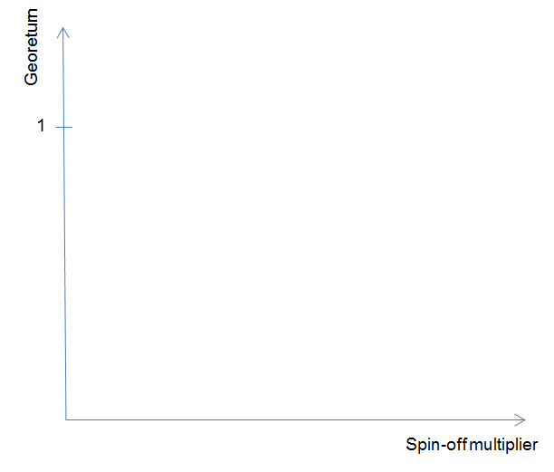
Successful ESA membership
Ideal state!
It takes time to take off
X-axis – scale?
Different criteria for different stakeholders
Private vs social
Reasonable?
Waste of resources?

Slide 28
Estonian industry and ESA

Slide 29
Estonian suppliers to ESA
2010
2013
2014
2016
PECS-1
PECS-2
PECS-3
Industry Incentive Scheme
Myoton
43 dB (Streago)
Reach-U
Skeleton Technologies
Eesti Materjalitehnoloogiate Arenduskeskuse AS
CGI Eesti
Tensiotrace
IB Krates
Satrian Aerospace
Regio/Reach-U
Skeleton Technologies
IAP
Vertex Estonia
CGI Eesti
Estrotech
IB Krates
Kappazeta
Modesat/Xilinx
Invent Baltics

Slide 30
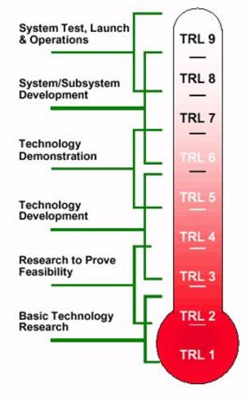
Technological effects
Advancing innovative technologies
BUT
at low maturity level (TRL)
Conditions set in AO
VC
H2020
H2020
VC
ESA
ESA

Slide 31
Technological effects
„...We would not have developed a prototype without an ESA contract...“
„...We developed new competences enabling us to compete for commercial contracts and public tenders in nearby countries...“
„...We built up unique competence improving our status inside a large multinational corporation...“

Slide 32
Commercial effects
ESA as a marketing reference – expansion of business networks of ESA suppliers
Access to new contacts, incl. major players
Unsolicited orders from customers
Qualification requirements in international tenders
ESA as a quality badge – positive signals to (international) equity investors
2 cases in Estonia!

Slide 33
Other important effects
Critical mass building
Access to resources – positive impacts on the bargaining position in labour market

Slide 34
Commercial effects in the long-run
ESA as a gateway to international business networks and space value chain
Partnerships with LSIs
Entry to commercial space markets
BUT it requires business development effort, dedicated staff, and good communication and language skills

Slide 35
Benefits from ESA
Georeturn system is favorable to small member states, such as Estonia and Latvia!
PPI brings along not only innovation but also internationalization of companies

Slide 36
Beware that...
... ESA can be a valuable strategic partner but it not cannot sustain a company (due to ESA procurement cycles)!
...there will be only a few national champions (‘perennial’ suppliers) and this is normal

Slide 37
Thank you! Questions and comments?

